Slide 1
Lecture 1
Database Fundementals
by:
Ahmed Adel

Slide 2
Basic Definitions
Database: A collection of related data.
Database: A Structured collection of Records.
Database Management System (DBMS): A software package/ system to facilitate the creation and maintenance of a computerized database.
Database System: The DBMS software together with the data itself. Sometimes, the applications are also included. ( Software + Database )

Slide 3
Single Table Data Base

Slide 4
ISBN | Title | AUID | AUName | AUTel | PubID | PubName | PubTel | Price
099-9999-1 | Emma | 1 | Austen | 222-33333 | 1 | Big House | 222-33333 | 20
091-88881 | Ferry | 5 | Jones | 33-555555 | 1 | Big House | 222-33333 | 17
082-44444 | Hamlet | 2 | Fedd | 44-777777 | 2 | Alpha Press | 666-88888 | 20
034-22234 | Hank | 6 | Sam | 66-444444 | 1 | Big House | 222-33333 | 25
071-22222 | Mazi | 2 | Fedd | 44-777777 | 2 | Alpha Press | 666-88888 | 27
043-55555 | Rios | 8 | Mark | 55-333333 | 3 | Small House | 444-99999 | 30
043-55555 | Rios | 9 | Joe | 22-567894 | 3 | Small House | 444-99999 | 30
054-66666 | Hazard | 8 | Steven | 44-555555 | 1 | Big House | 222-33333 | 23
034-56789 | Ballon | 12 | Alberto | 33-666666 | 2 | Small House | 444-99999 | 25
034-56789 | Ballon | 13 | Jack | 77-999999 | 2 | Small House | 444-99999 | 25
034-56789 | Ballon | 14 | Hewit | 234-55555 | 2 | Small House | 444-99999 | 25

Slide 5
Single Table Disadvantages
Duplication of Data
Insert Anomaly
Delete Anomaly
Update Anomaly
Frequent Null Values
Notes:
Duplication of Data – The same data is listed in multiple lines of the database
Insert Anomaly – A record about an entity cannot be inserted into the table without first inserting information about another entity – Cannot enter a customer without a sales order
Delete Anomaly – A record cannot be deleted without deleting a record about a related entity. Cannot delete a sales order without deleting all of the customer’s information.
Update Anomaly – Cannot update information without changing information in many places. To update customer information, it must be updated for each sales order the customer has placed
Using few Null values as possible: Attributes that are NULL frequently could be placed in separate relations (with the primary key)

Slide 6
DBMS Advantages
Controlling Redundancy.
Restricting Unauthorized Access.
Sharing data.
Enforcing Integrity Constraints
Inconsistency can be avoided.
Providing Backup and Recovery.

Slide 7
DBMS Disadvantages
It needs expertise to use (which is expensive)
DBMS itself is expensive
The DBMS may be incompatible with any
other available DBMS

Slide 8
Database Users
Database Administrator (DBA)
System Analysts
Database Designer
Application programmers
Testing Unit
Analyze & Calculate & Summary Data (BI)
End users

Slide 9
Relational Database
Relational database Lifecycle divided into these stages:
ERD
Mapping
Implementation of database
Querying Data

Slide 10
Entity Relationship Modeling
Entity-Relationship Diagram (ERD): identifies information required by the business by displaying the relevant entities and the relationships between them.

Slide 11
Entity Relationship Modeling (Cont’d)
In building a data model a number of questions must be addressed:
  What entities need to be described in the model?
  What characteristics or attributes of those entities need to be recorded?
  Can an attribute or a set of attributes be identified that will uniquely identify one specific occurrence of an entity?
  What associations or relationships exist between entities?

Slide 12
Definitions
Entity - An entity is a thing that exists and is distinguishable -- an object, something in the environment. ( Types of entities: Weak- Regular)
Entity Instance - An instance is a particular occurrence of an entity. For example, each person is an instance of an entity, each car is an instance of an entity, etc.

Slide 13
Types of Attributes
Key
Multi-valued
Composite
Derived

Slide 14
Key Attribute
An attribute of an entity type for which each entity must have a unique value is called a key attribute of the entity type. For example, SSN of EMPLOYEE.
A key attribute may be composite. For example, ID is a key of the applicant entity type with components (National_ID, Application_no).
Candidate Key: An entity type may have more than one key.
Notes:
ITI Case study
Applicant ID + Appno

Slide 15
PARTICIPATION CONSTRAINT
Has
Employee
Car
An Employee may have a car.
A Car must be assigned to particular employee

Slide 16
PARTICIPATION CONSTRAINT
Hire
Department
Employee
- A department may hire many employees ( Zero or more)
An employee must be employed by a department
(Department membership is Optional, Employee membership is Mandatory)

Slide 17
PARTICIPATION CONSTRAINT
An employee MUST work for a department
An employee entity can exist only if it participates in a WORKS_FOR relationship instance
Thus its participation is TOTAL
Only some employees manage departments
The participation is PARTIAL
A formal constraint: (min,max) where m, n are min and max number of times an entity participates in a relationship instance. For example, (0,10) means partial participation, and (1,max) means total participation.

Slide 18
Weak Entity Types
An entity that does not have a key attribute
A weak entity must participate in an identifying relationship type with an owner or identifying entity type
Entities are identified by the combination of:
  A partial key of the weak entity type
  The particular entity they are related to in the identifying entity type
Notes:
Example:
Suppose that a DEPENDENT entity is identified by the dependent’s first name and birth date, and the specific EMPLOYEE that the dependent is related to. DEPENDENT is a weak entity type with EMPLOYEE as its identifying entity type via the identifying relationship type DEPENDENT_OF

Slide 19
Relationships
Relationships - A relationship is a connection between entity classes.
The cardinality of a relationship indicates the number of instances in entity class E1 that can or must be associated with instances in entity class E2.
  One-One Relationship - (citizen – passport ,
  One-Many Relationship - (student-Advisor, Customer-Order)
  Many- Many Relationship - (e.g. Student-Organization, Order-Products)
  Recursive Relationships - A relationship in which the same entity participates more than once.
Notes:
Relationship: Establishes a connection or correspondence or link between a pair of tables in a database, or between a pair of entities in an entity-relationship diagram (ERD).
One-to-one relationship: A single record in table A is related to only one record in table B, and vice versa.
One-to-many relationship: A single record in table A can be related to one or more records in table B, but a single record in table B can be related to only one record in table A.
Many-to-many relationship: A single record in table A can be related to one or more records in table B, and vice versa. Problems with many-to-many relationships: one of the tables will contain a large amount of redundant data, both tables will contain some duplicate data, it will be difficult to add, update, delete records because of the duplication of fields between tables.

Slide 20
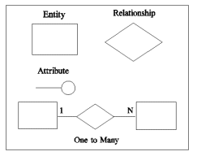
ERD Notations
Rectangles represent ENTITY CLASSES
Circles represent ATTRIBUTES
Diamonds represent RELATIONSHIPS
Arcs - Arcs connect entities to relationships. Arcs are also used to connect
attributes to entities. Some styles of entity-relationship diagrams use arrows
and double arrows to indicate the one and the many in relationships.
Some use forks etc.
Underline - Key attributes of entities are underlined.

Slide 21
SUMMARY OF ERD NOTATION
Symbol
Meaning
ENTITY TYPE
WEAK ENTITY TYPE
RELATIONSHIP TYPE
IDENTIFYING RELATIONSHIP TYPE
ATTRIBUTE
KEY ATTRIBUTE
MULTIVALUED ATTRIBUTE
COMPOSITE ATTRIBUTE
DERIVED ATTRIBUTE
TOTAL PARTICIPATION OF E₂ IN R
CARDINALITY RATIO 1:N FOR E₁:E₂ IN R
STRUCTURAL CONSTRAINT (min, max) ON PARTICIPATION OF E IN R
E₁
R
E₂
E₁
R
N
E₂
R
(min,max)
E
Notes:
Guidelines:
• The existence of a relationship between two entities is drawn as a line connecting the entities.
• Arrows at the ends of the lines indicate different types of relationships (one-to-one, one-to-many, many-to-many)
• Verbs may be placed on the relationship lines that describe what the relationships mean (e.g. “addresses locate businesses”, where “addresses” and “businesses” are related entities, and “locate” is
the verb describing the relationship.)
• Lists of attributes are developed as you go. (An attribute is a single piece of information that is descriptive of an entity, e.g. friend name, friend e-mail.)
• A single attribute for each entity is selected (or an arbitrary one is assigned) as being the unique identifier for each occurrence of the entity (e.g. business id number to uniquely identify a business).

Slide 22
An Example
A company is organized into departments. Each department has a unique name, a unique number, and a particular employee who manages the department. A department may have several locations.
A department may control a number of projects, each of which has a unique name, a unique number, and a single location. A project must controlled by department

Slide 23
An Example (Cont’d)
We store employee’s name, social security number, address, salary, gender and birth date. An employee must be assigned to one department and must work on one or more projects, which are not necessarily controlled by the same department. We keep track of the number of hours per week that an employee works on each project. We also keep track of the direct supervisor of each employee.
We want to keep track of the dependents of each employee for insurance purposes. We keep each dependent’s first name, gender, birth date and relationship to that employee.

Slide 24
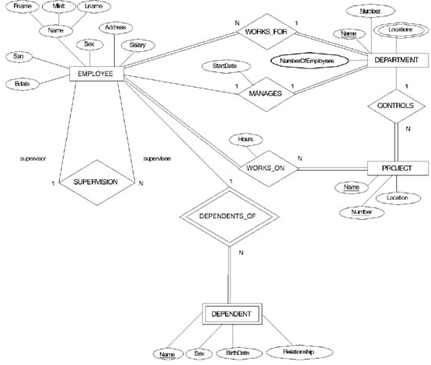

Slide 25
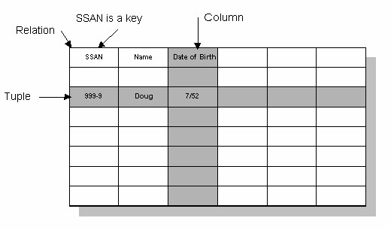
Relational Database
Domain
Notes:
Integrity Constraints : ( PK, UK, NN, FK, Check)
Data types

Slide 26
ER-to-Relational Mapping
Step 1: Mapping of Regular Entity Types
Step 2: Mapping of Weak Entity Types
Step 3: Mapping of Binary 1:1 Relation Types
Step 4: Mapping of Binary 1:N Relationship Types.
Step 5: Mapping of Binary M:N Relationship Types.
Step 6: Mapping of Multi-valued attributes.

Slide 27
Step 1: Mapping of Regular Entity Types
Create table for each entity type
Choose one of key attributes to be the primary key

Slide 28
Step 2: Mapping of Weak Entity Types
Create table for each weak entity.
Add foreign key that correspond to the owner entity type.
Choose the primary key : ( FK + weak entity Partial PK if any)

Slide 29
Step 3: Mapping of Binary 1:1 Relation Types
Merged two tables if both sides are Mandatory.
Add FK into table with the total participation relationship to represent optional side.
Create third table if both sides are optional.

Slide 30
Step 4: Mapping of Binary 1:N Relationship Types.
Add FK to N-side table
Add any simple attributes of relationship as column to N-side table.

Slide 31
Step 5: Mapping of Binary M:N Relationship Types.
Create a new third table
Add FKs to the new table for both parent tables
Add simple attributes of relationship to the new table if any .

Slide 32
Step 6: Mapping of Multi-valued attributes.
Create new table for each multi-valued attribute
Table will include two columns.
one for multi-valued attribute + FK column.

Slide 34

Mapping Result

Slide 35
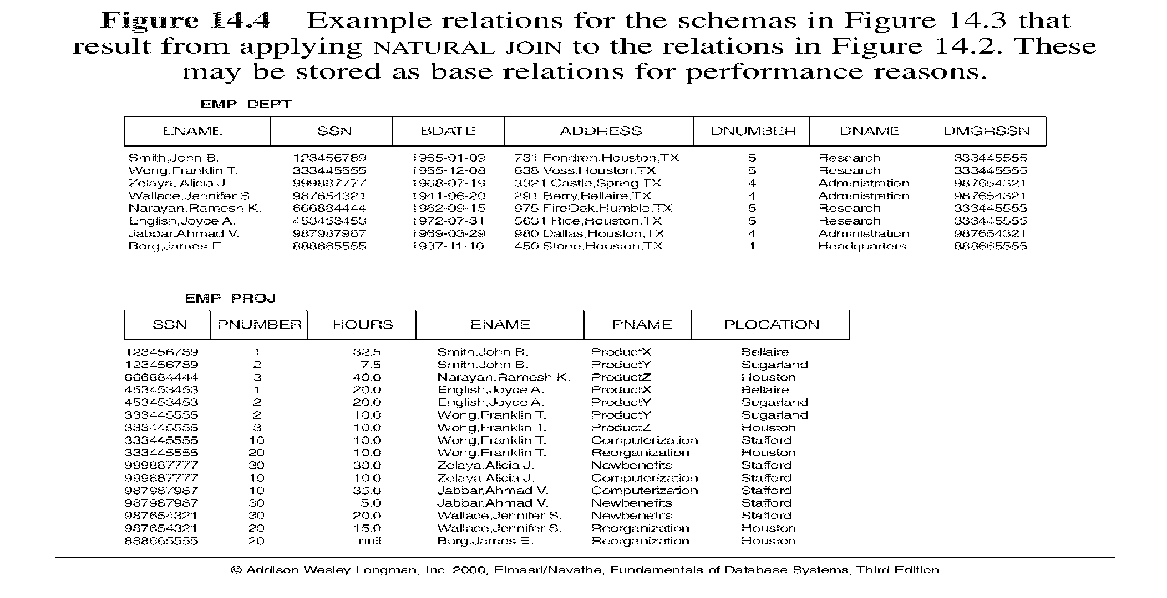
Normalization
Why do we use Normalization?
Notes:
ERD is Top down
Normalization is bottom up
normalization plays only a limited role in database schema design if a top-down modeling approach like the entity- relationship approach is used.
Normalization however plays a major role when the bottom-up approach is being used. Normalization is then essential to build appropriate relations to hold the information of the enterprise.

Slide 36
Normalization Avoids
Duplication of Data
Insert Anomaly
Delete Anomaly
Update Anomaly
Frequent Null Values
Notes:
Duplication of Data – The same data is listed in multiple lines of the database
Insert Anomaly – A record about an entity cannot be inserted into the table without first inserting information about another entity – Cannot enter a customer without a sales order
Delete Anomaly – A record cannot be deleted without deleting a record about a related entity. Cannot delete a sales order without deleting all of the customer’s information.
Update Anomaly – Cannot update information without changing information in many places. To update customer information, it must be updated for each sales order the customer has placed
Using few Null values as possible: Attributes that are NULL frequently could be placed in separate relations (with the primary key)

Slide 37
Functional dependency
a constraint between two attributes (columns) or two sets of columns
A → B if “for every valid instance of A, that value of A uniquely determines the value of B”
or …A →B if “there exists at most one value of B for every value of A”
Notes:
Functional dependencies (FDs) are used to specify formal measures of the "goodness" of relational designs
FDs and keys are used to define normal forms for relations
FDs are constraints that are derived from the meaning and interrelationships of the data attributes
A set of attributes A functionally determines a set of attributes B if the value of A determines a unique value for B

Slide 38
… functional dependency
some examples
social security number determines employee name
SSN -> ENAME
project number determines project name and location
PNUMBER -> {PNAME, PLOCATION}
employee ssn and project number determines the hours per week that the employee works on the project
{SSN, PNUMBER} -> HOURS
So functional dependency is the technical term for determines

Slide 39
keys and dependencies
EMPLOYEE1 (Emp_ID, Name, Dept_Name, Salary)
determinant
Emp_ID | Name | Dept_Name | Salary
functional dependency

Slide 40
EMPLOYEE2 (Emp_ID, Course_Title, Name, Address, Salary, Date_Completed)
Emp_ID | Course_ Title | Name | Address | Salary | Date_Comp.
not fully functionally dependant on the primary key

Slide 41
Definition
Normalization: The process of decomposing unsatisfactory "bad" relations by breaking up their attributes into smaller relations
Normal form: Condition using keys and FDs of a relation to certify whether a relation schema is in a particular normal form
Notes:
Normalization is carried out in practice so that the resulting designs are of high quality and meet the desirable properties
The practical utility of these normal forms becomes questionable when the constraints on which they are based are hard to understand or to detect
The database designers need not normalize to the highest possible normal form. (usually up to 3NF, BCNF or 4NF)
Denormalization: the process of storing the join of higher normal form relations as a base relation—which is in a lower normal form

Slide 42
1NF
relation is in first normal form if it contains no multivalued or composite attributes
remove repeating groups to a new table as already demonstrated, “carrying” the PK as a FK
All columns (fields) must be atomic
  Means : no repeating items in columns
Notes:
Disallows composite attributes, multivalued attributes, and nested relations; attributes whose values for an individual tuple are non-atomic
Considered to be part of the definition of relation

Slide 43
2NF
a relation is in second normal form if it is in first normal form AND every nonkey attribute is fully functionally dependant on the primary key
i.e. remove partial functional dependencies, so no nonkey attribute depends on just part of the key

Slide 44
EMPLOYEE2 (Emp_ID, Course_Title, Name, Address, Salary, Date_Completed)
Emp_ID | Course_ Title | Name | Address | Salary | Date_Comp.
not fully functionally dependant on the primary key

Slide 45
2NF
a relation is in 2NF if it is in 1NF and any one of these is true:
  the PK consists of only 1 attribute
  all attributes are part of the PK (no nonkey attributes)
  every non key attribute is functionally dependant on the whole PK

Slide 46
1NF →2NF
EMPLOYEE2 (Emp_ID, Course_Title, Name, Address, Salary, Date_Completed) ➔
EMPLOYEE1 (Emp_ID, Name, adress, Salary)
and
EMP_COURSE (Emp_ID, Course_Title, Date_Completed)
EMPLOYEE1 satisfies condition1
EMP_COURSE satisfies condition3

Slide 47
3NF
a relation is in third normal form if it is in 2NF, AND no transitive dependencies exist
transitive dependency is a functional dependency between nonkey attributes

Slide 48
transitive dependency
transitive
dependency
Cust_ID | Name | City | Region

Slide 49
Cust_ID | Name | city | Region
City | Region
Cust_ID | Name | City

Slide 50
ITI Example
ITI Students Sheet
Platform Name : SWE Platform Description: Software Engineering
Graduate Profile: ALL
Appno | Name | F-code | Faculty | Major | Address | Telno | Found. Grade | Total Att. Hrs | Start date
123 | Ahmed | SC-phy | Science | Physics | Haram | 33868420 | A | 600 | 14 Sep
124 | Mona | Eng-cs | Engineering | Computer | Dokki | 33897455,33897445 | B | 591 | 15 Sep
127 | Ali | Com-ac | Commerce | Accounting | Nasr City | 22415939 | A | 550 | 21 Sep
223 | Karim | Med-bio | Medicine | Biochemistry | Sheraton | 22868456 | C | 600 | 14 Sep
Notes:
1NF :
Platform :pfname , pfdesc , pfgraduate
Students: pfname, appno, name , f-code ,faculty , major , address, Foundgrade, attd , start_date
Std_Tel: appno, telno
2NF:
Students: appno, name , f-code , faculty , major , address
Students_pf: pfname,appno, Foundgrade, attd , start_date
Unchanged Tables
Platform :pfname , pfdesc , pfgraduate
Std_Tel: appno, telno
3NF
Students: appno, name , f-code, address
Fac_majors:f-code , faculty name , major
Unchanged Tables
Platform :pfname , pfdesc , pfgraduate
Std_Tel: appno, telno
Students_pf: pfname,appno, Foundgrade, attd , start_date

Slide 51
1st Normal Form
Normalization: First Normal Form
Separate Repeating Groups into New Tables.
Repeating Groups Fields that may be repeated several times for one document/entity
Create a new table containing the repeating data
The primary key of the table (repeating group) is always a composite key; Usually document number and a field uniquely describing the repeating line, like an item number.

Slide 52
1NF :
Platform :pfname , pfdesc , pfgraduate
Students: pfname, appno, name , faculty , major , address, Foundgrade, attd , start_date
Std_Tel: appno, telno

Slide 53
2NF
Students: appno, name , f-code, faculty , major , address
Students_pf: pfname,appno, Foundgrade, attd , start_date
Unchanged Tables
Platform :pfname , pfdesc , pfgraduate
Std_Tel: appno, telno

Slide 54
3NF
Students: appno, name , f-code, address
Fac_majors: f-code, faculty , major
Unchanged Tables
Platform :pfname , pfdesc , pfgraduate
Std_Tel: appno, telno
Students_pf: pfname,appno, Foundgrade, attd , start_date

